Slide 1
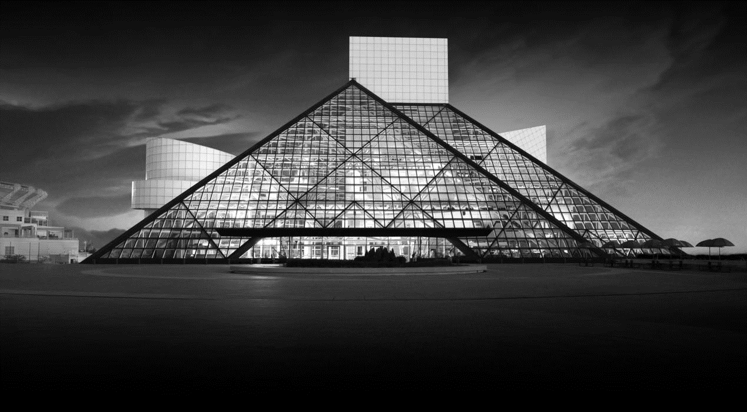
PREDICTING THE ROCK AND ROLL HALL OF FAME Grayson Bates, Michael Borenstein and Andrew Malanowski

Slide 2
Algorithms Used To Explore Our Model
Logistic Regression
Decision Trees
Random Forest
Support Vector Machines
Naïve Bayes

Slide 3
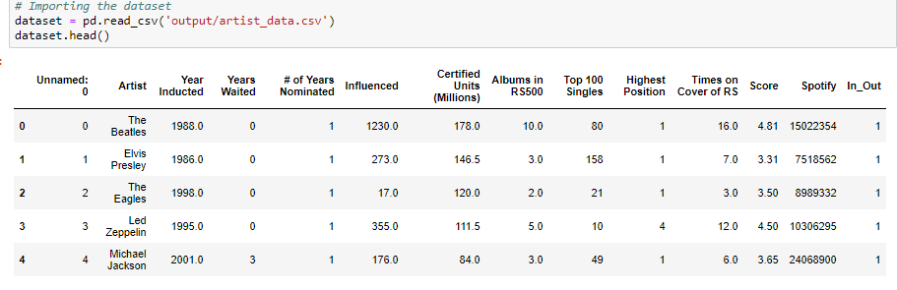

Slide 4
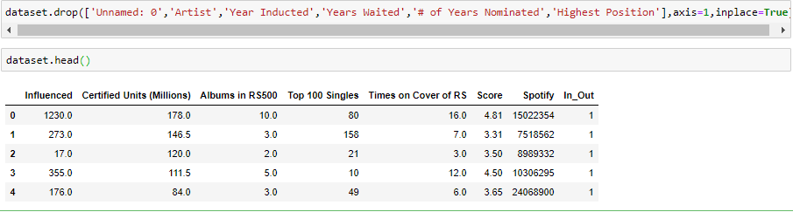

Slide 5
Code Template:
# Importing the libraries
import numpy as np
import matplotlib.pyplot as plt
import pandas as pd
# Importing the dataset
dataset = pd.read_csv(‘Example.csv')
X = dataset.iloc[:, [specific column indexes here]].values
y = dataset.iloc[:, specific column index here].values
# Splitting the dataset into the Training set and Test set
from sklearn.cross_validation import train_test_split
X_train, X_test, y_train, y_test = train_test_split(X, y, test_size = 0.30, random_state = 0)
# Feature Scaling
from sklearn.preprocessing import StandardScaler
sc = StandardScaler()
X_train = sc.fit_transform(X_train)
X_test = sc.transform(X_test)

Slide 6
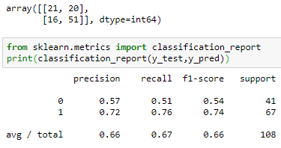
Support Vector Machines
66% precision
72 correct predictions
36 incorrect predictions
Conclusion: We need a better model!

Slide 7
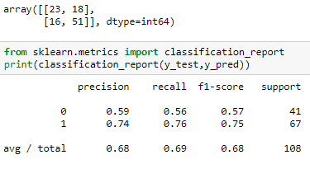
Logistic Regression
68% precision
74 correct predictions
34 incorrect predictions
A decent score, but we still wanted a better performing algorithm!

Slide 8
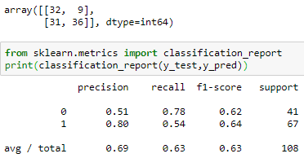
Naive Bayes
Precision of 69%
68 correct predictions
40 incorrect predictions
Getting there, but we wanted our model to at least get us into the 70s.

Slide 9

BACKGROUND
Founded in 1983 by Atlantic Records founder Ahmet Ertegun, Rolling Stone founder Jann Wenner, longtime Bruce Springsteen manager Jon Landau and a small group of music executives, managers and attorneys.
214 artists have been inducted as performers since annual inductions began in 1986.
The nominating committee, chaired by Landau, currently consists of 29 members, and nominates 15 artists each year. The only criteria is that it has been 25 years since the artist’s first record was released.
Ballots are then sent to 600 “rock experts.” Artists with the highest number of votes and more than 50% of the vote are inducted. Number of inductees varies.

